Slide 1

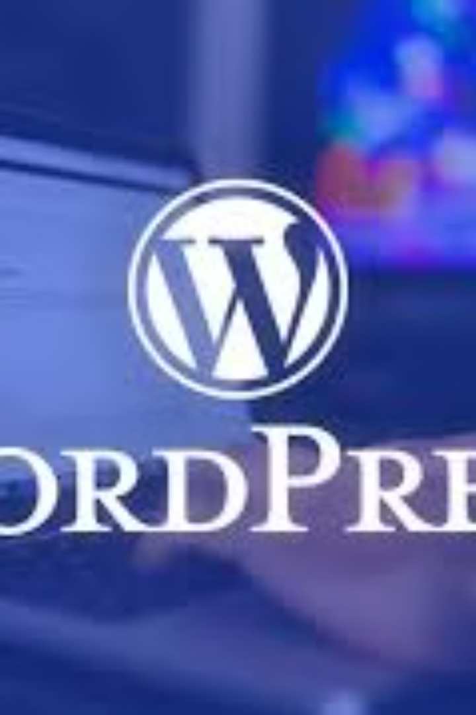
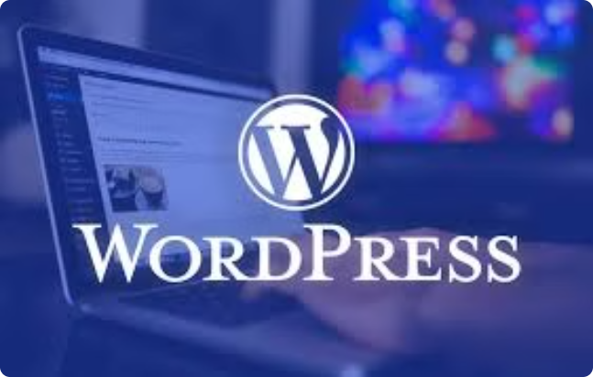
Title
web development with word press

Slide 2

what is word press
WordPress is a popular open-source content management system used to create websites, blogs, and online stores.
Definition of word press & brief history
WordPress, content management system (CMS) developed in 2003 by American blogger Matt Mullenweg and British blogger Mike Little. WordPress is most often used to create blogs, but the program is sufficiently flexible that it can be used to create and design any sort of website.

Slide 3

Benefits of using WordPress for web development
Flexibility: WordPress offers a wide range of themes and plugins for customizing websites to meet specific needs.
User-Friendly: Its intuitive interface makes it easy for non-technical users to update content and manage the site.
SEO-Friendly: WordPress is built with SEO in mind, allowing for better visibility and ranking on search engines.

Slide 4
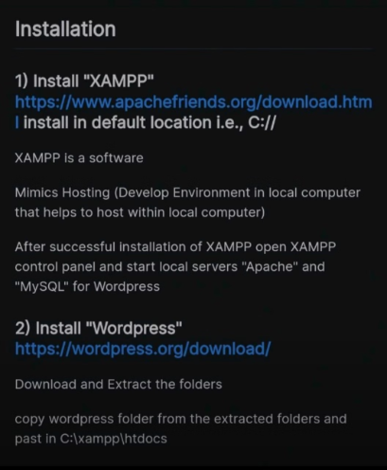
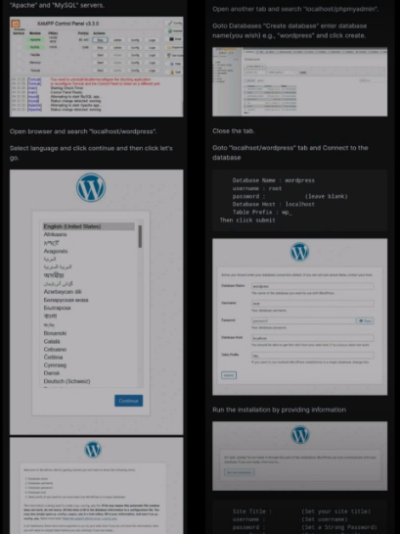
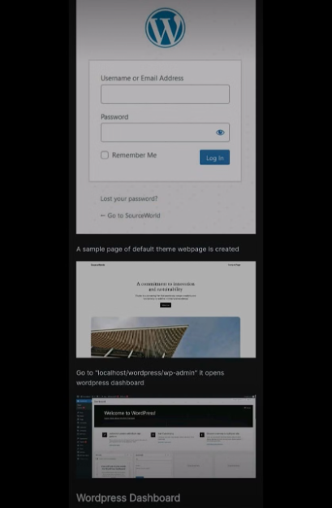
Installation process of word press with live sever

Slide 5
Setting up a WordPress site
Choose a Domain and Hosting
Install WordPress
Select a domain name that reflects your brand and reliable hosting to ensure your site's performance.
Follow the simple installation process to get WordPress up and running on your hosting server.
Customize Permalinks
Set Up Basic Settings
Optimize your site's URLs for search engines and visitors by setting up SEO-friendly permalinks.
Configure site title, tagline, timezone, and other essential settings to personalize your WordPress site.

Slide 6
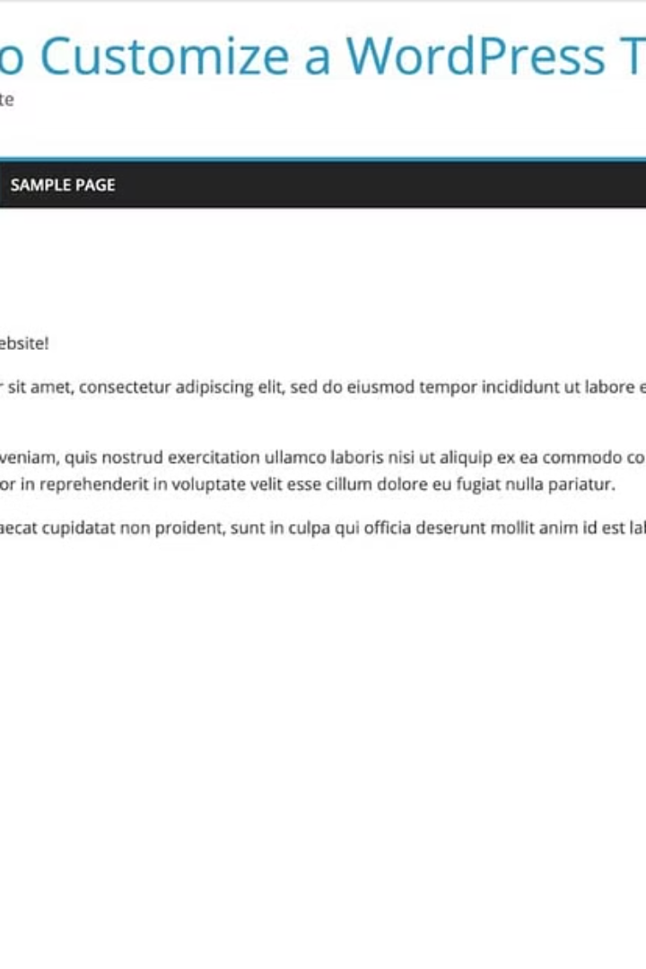
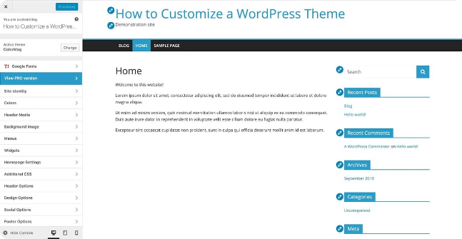
Choosing and Customizing a Theme
When selecting a theme for your WordPress site, consider design, responsiveness, and customization options. Choose a theme that aligns with your brand and site goals. After choosing a theme, customize it by adding a logo, changing colors, and adjusting layouts to match your brand aesthetic.
Ensure the selected theme is user-friendly and provides a seamless experience for site visitors. Prioritize responsiveness and performance to create an engaging and effective online presence.

Slide 7

Adding and managing content
Adding and managing content in WordPress is a seamless process. The user-friendly interface allows for easy creation and updating of pages, posts, and media. You can also schedule content publication and categorize posts for better organization.
Additionally, the built-in media library simplifies the management of images, videos, and audio files. You can optimize images directly within the platform, ensuring fast load times for your website.
With the ability to customize permalinks and use tags and categories, WordPress offers a comprehensive content management experience. It also supports multi-author collaboration, allowing for efficient content creation and editing.

Slide 8



Installing and configuring plugins
Installation Process
Activation Steps
Choosing Compatible Plugins
Learn how to install plugins seamlessly to enhance functionality.
Understand the activation process for utilizing new plugins effectively.
Identify and select plugins that work harmoniously with your WordPress site.

Slide 9
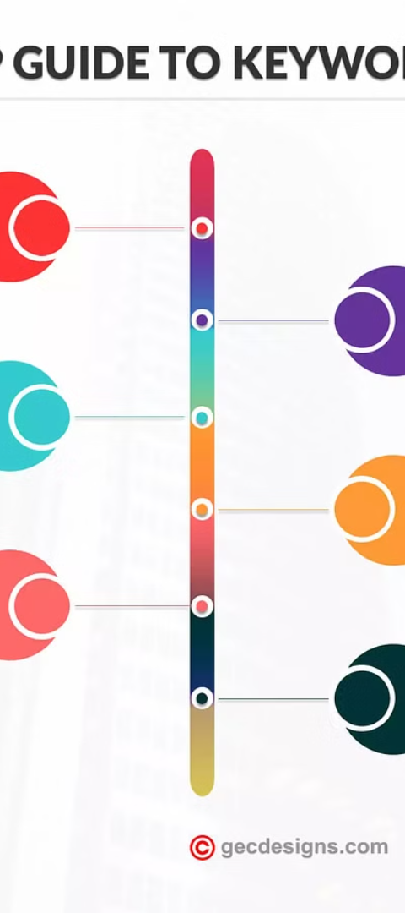
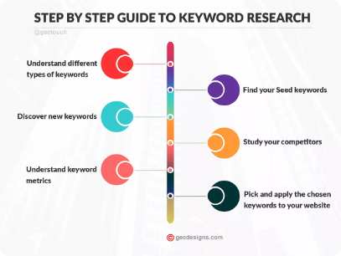
Optimizing WordPress for SEO
1
Keyword Research
Identify relevant keywords with high search volume and low competition.
2
On-Page Optimization
Optimize title tags, meta descriptions, and content for targeted keywords.
3
Link Building
Develop a strategy to acquire quality backlinks from reputable websites.

Slide 10
Ensuring Website Security
Update Software
1
Regularly update WordPress core, themes, and plugins.
Use Secure Passwords
2
Implement strong passwords and two-factor authentication.
Install Security Plugins
3
Utilize reputable security plugins for added protection.
Regular Backups
4
Set up automated backups to protect against data loss.

Slide 11
Best practices for WordPress web development
User-friendly Navigation
Mobile Responsiveness
Optimized Performance
Security Measures
Ensure clear and intuitive navigation to enhance the user experience and help visitors find information easily.
Optimize your WordPress site for mobile devices to reach a wider audience and improve search engine rankings.
Implement caching, minimize HTTP requests, and optimize images to improve site speed and user experience.
Enforce strong password policies, use SSL certificates, and regularly update themes and plugins to enhance website security.
Use breadcrumbs, logical page hierarchies, and search functionality for seamless navigation.
Regularly monitor and optimize website performance for faster loading times.
Use responsive design, fast loading times, and mobile-friendly plugins.
Perform security audits, utilize firewalls, and implement security plugins to safeguard the WordPress site.

Slide 12
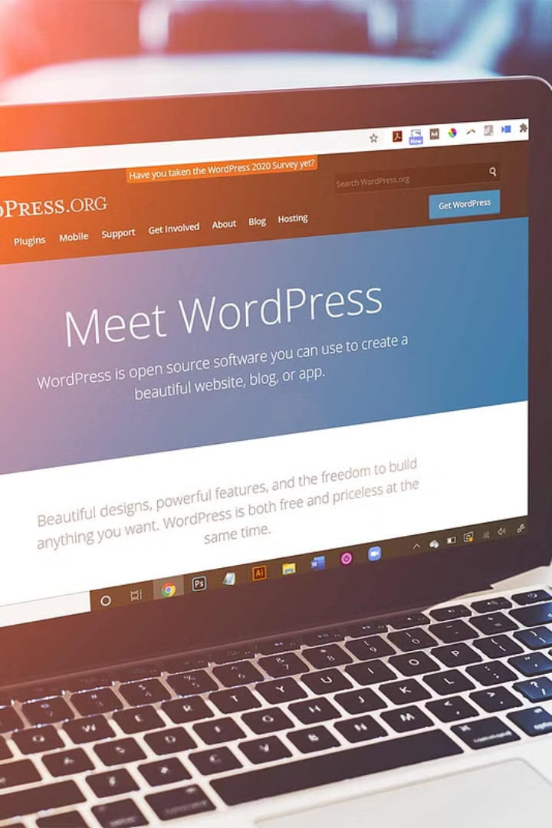
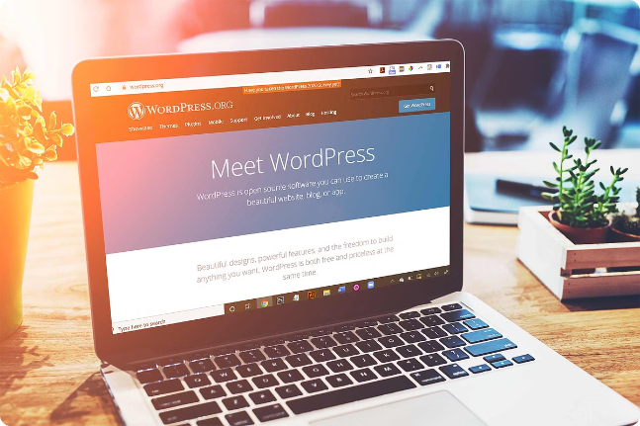
Conclusion and Next Steps
Now that you've learned about WordPress web development, it's time to put your knowledge into action. Consider creating a development environment to practice your skills, or start building your first WordPress website. Remember to stay updated on WordPress best practices for continuous improvement.

Slide 13

Thanking you

